Slide 1


Odontex Dental Lab Scanner Connection Guide

Slide 2
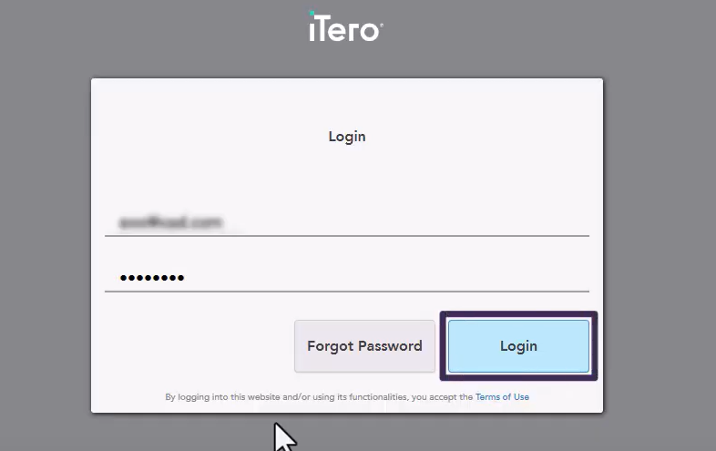
Step 1: Go to myitero.com on any computer and log in using your username and password

Slide 3
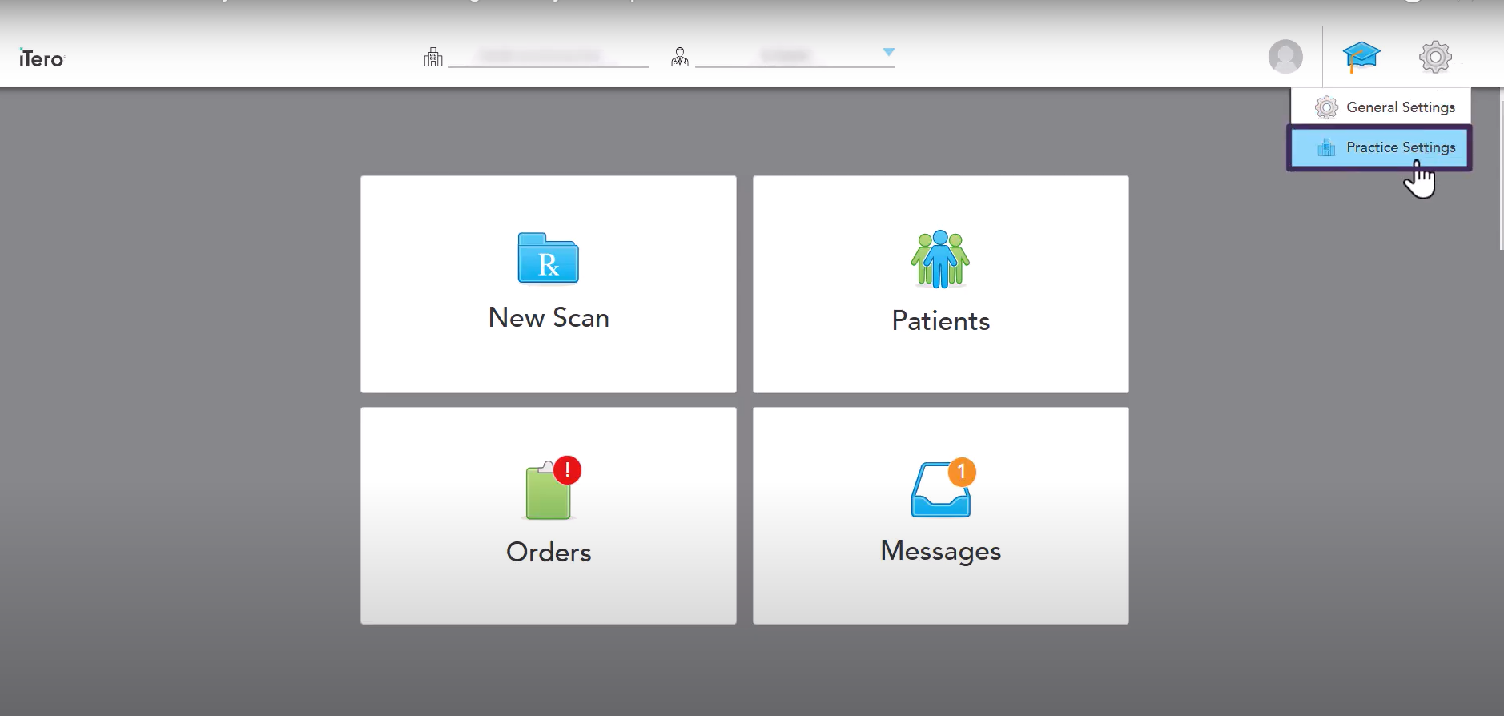
Step 2 : On the home screen, click Settings, then select Practice Settings

Slide 4
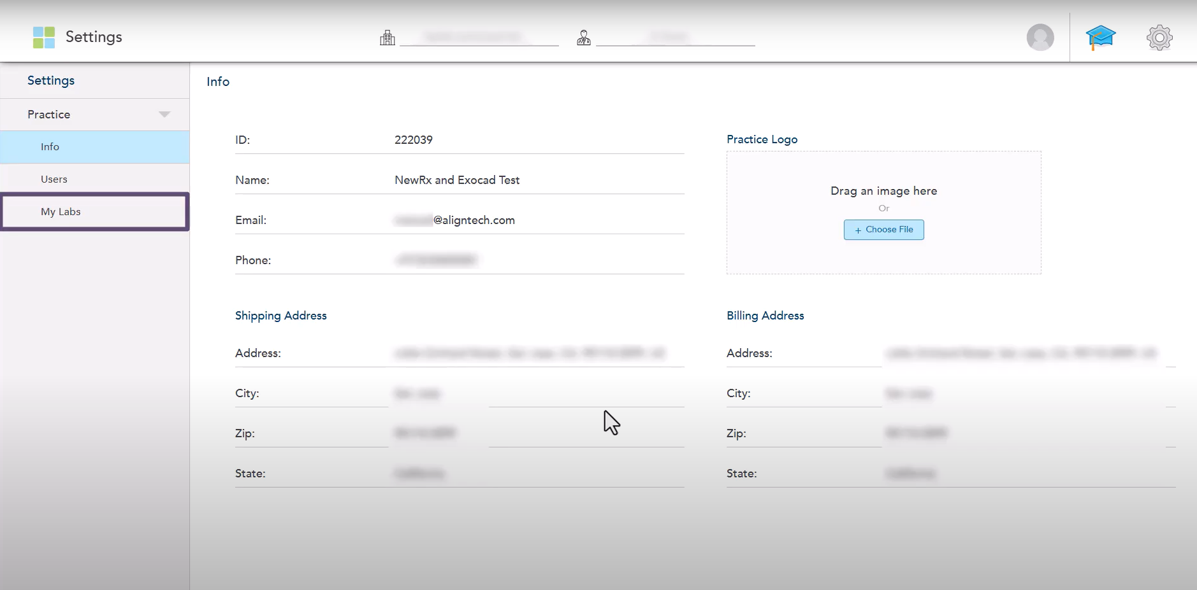
Step 3 : In the Settings page, click My Labs.

Slide 5
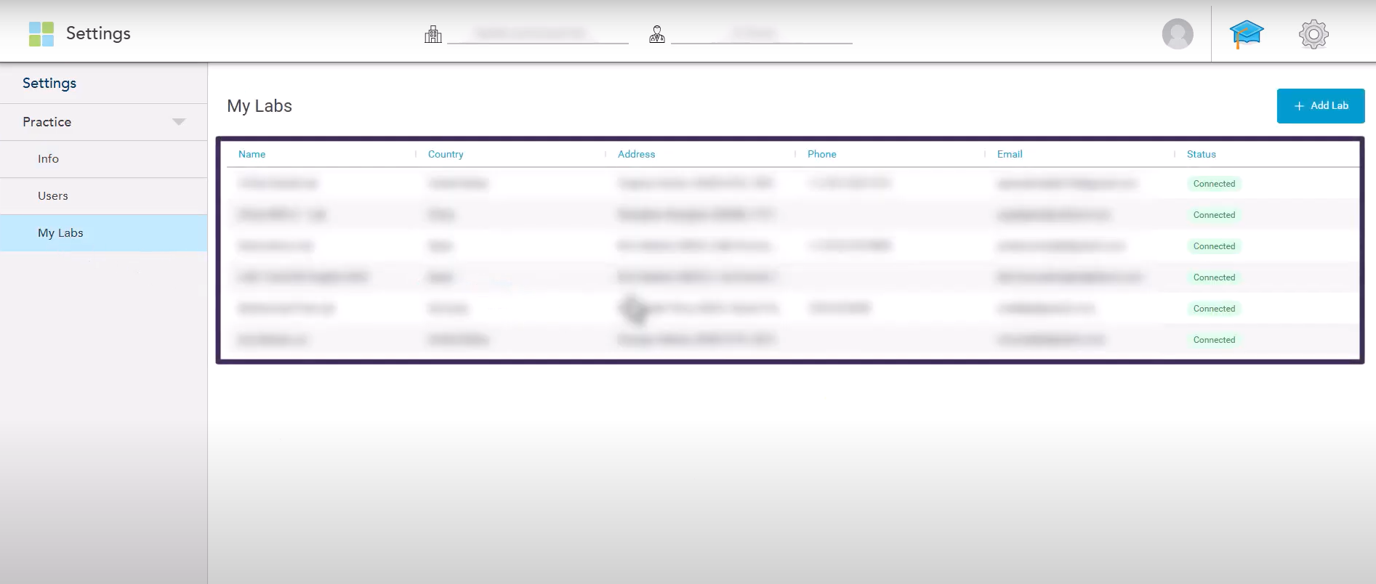
Step 4 : All labs currently connected with your clinic will be listed here.

Slide 6
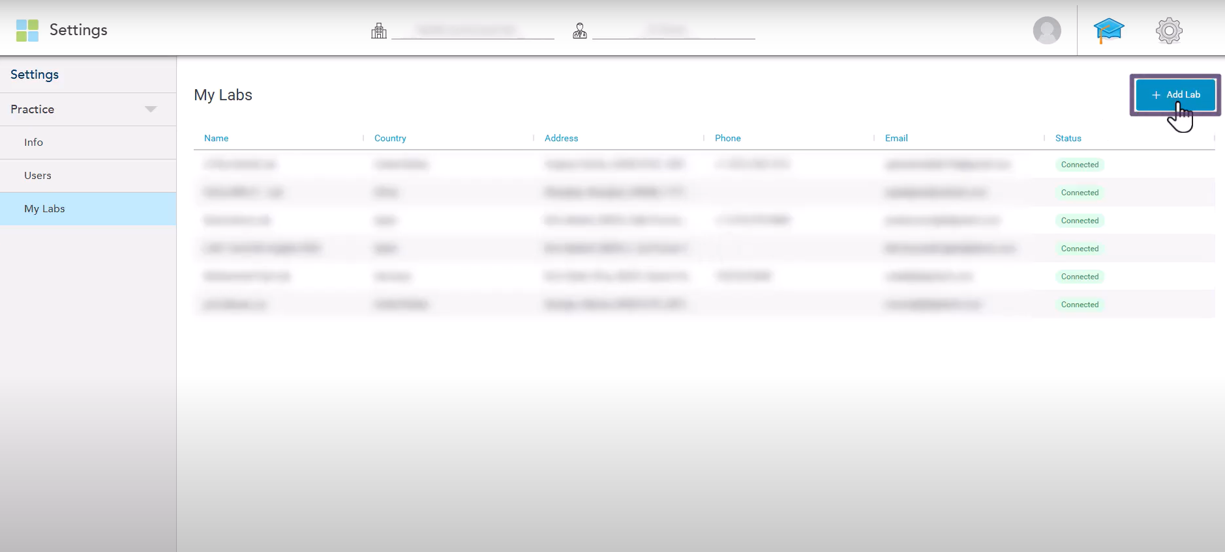
Step 5 ：To add a new lab, click the Add Lab button.

Slide 7
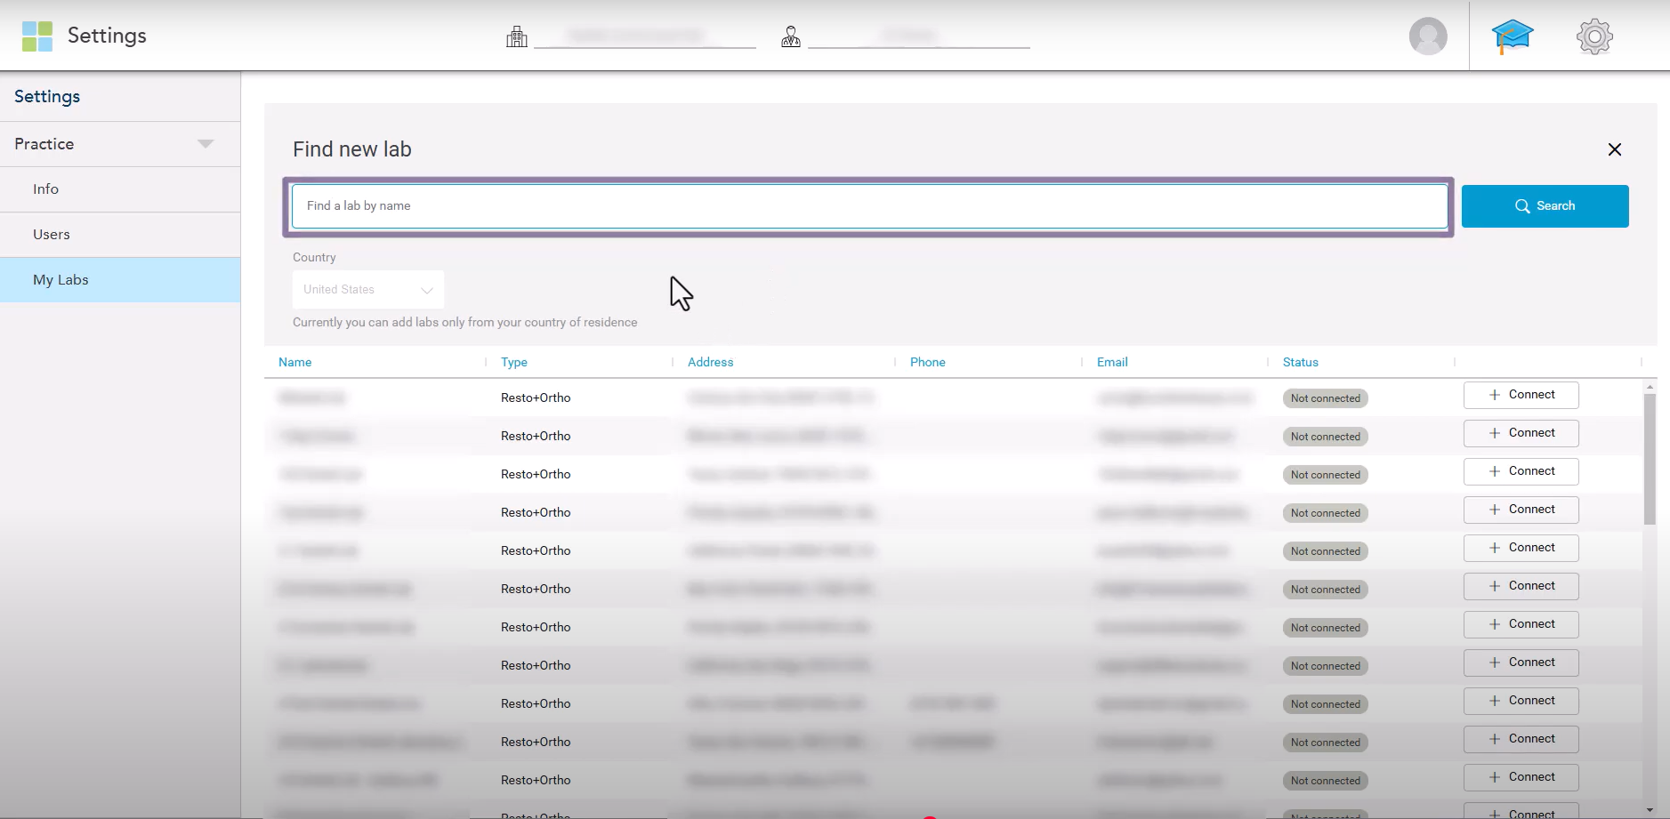
Step 6 : In the search field, enter our lab’s name “Odontex”, then click Search

Slide 8
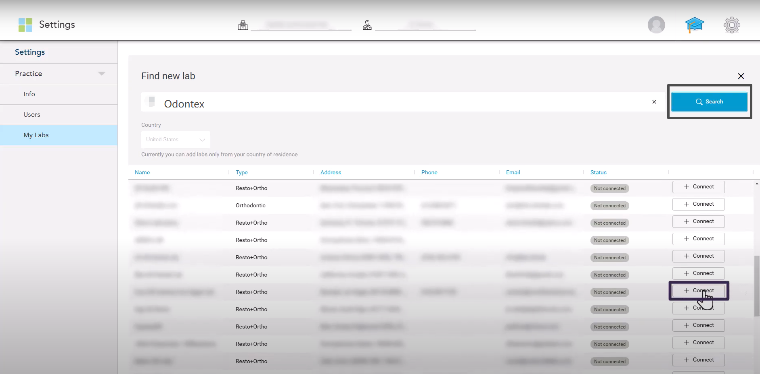
Step 7 : The system will display all labs matching your search criteria. Locate Odontex and click Connect

Slide 9
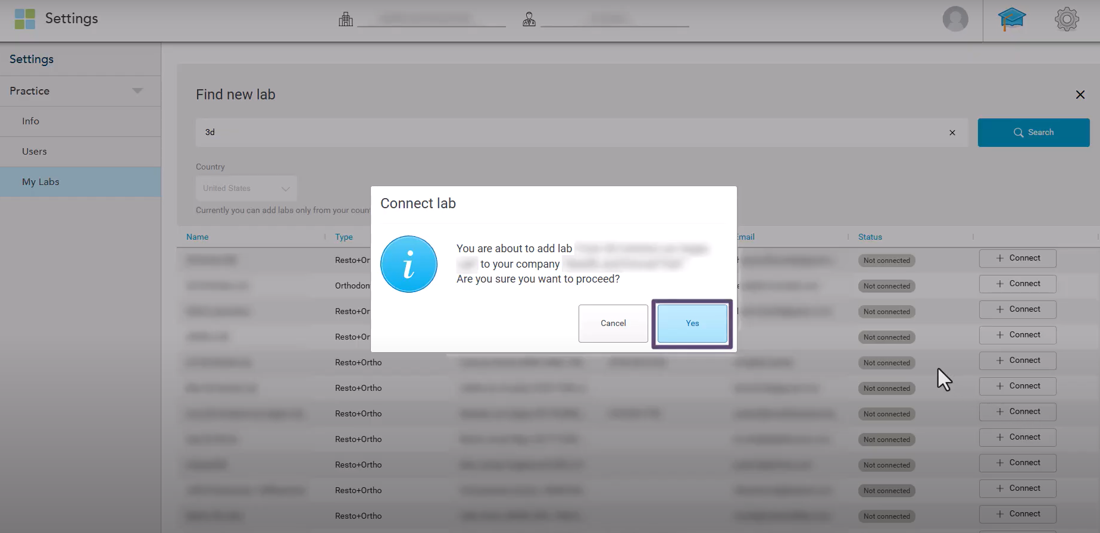
Step 8: A confirmation message will appear — click Yes to confirm the connection

Slide 10
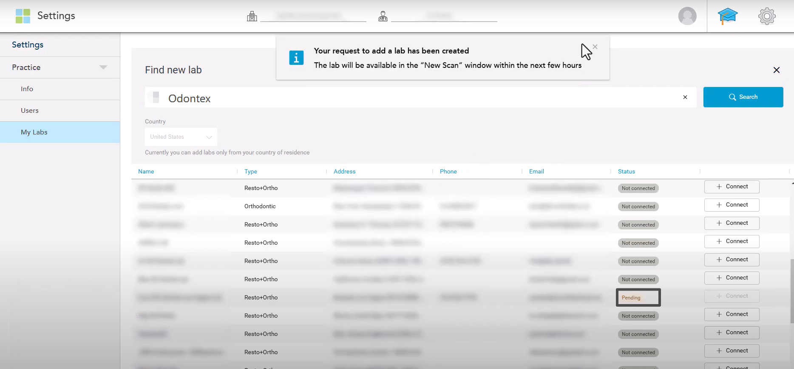
Step 9 : Our lab will receive an email notification about your connection request

Slide 11
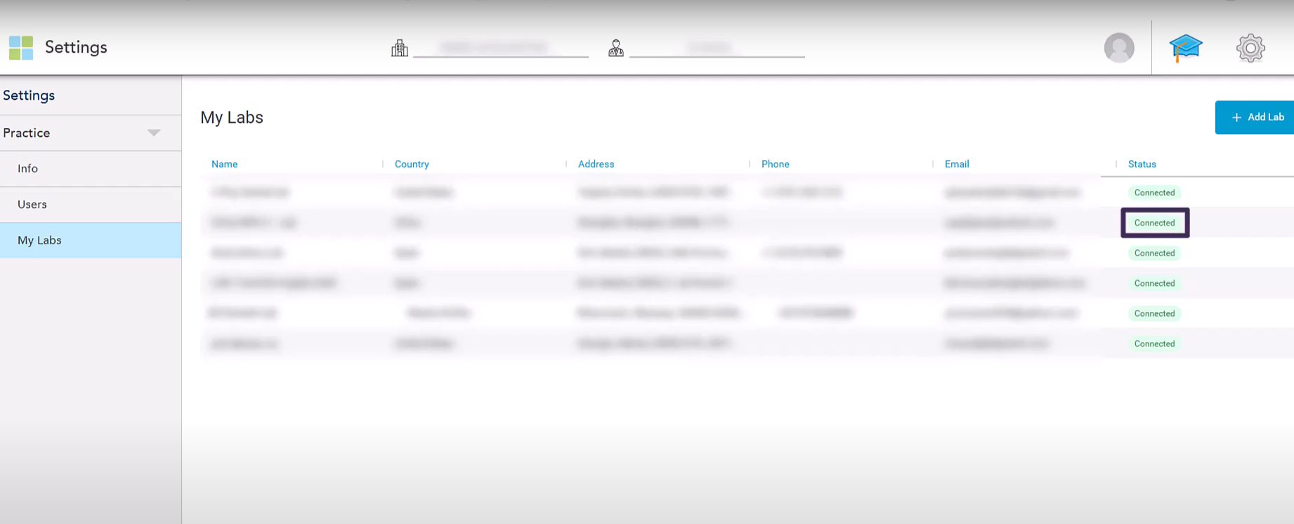
Step 10 : The newly added lab will appear at the top of your lab list with a Pending status. Once we accept the request, it will change to Connected

Slide 12
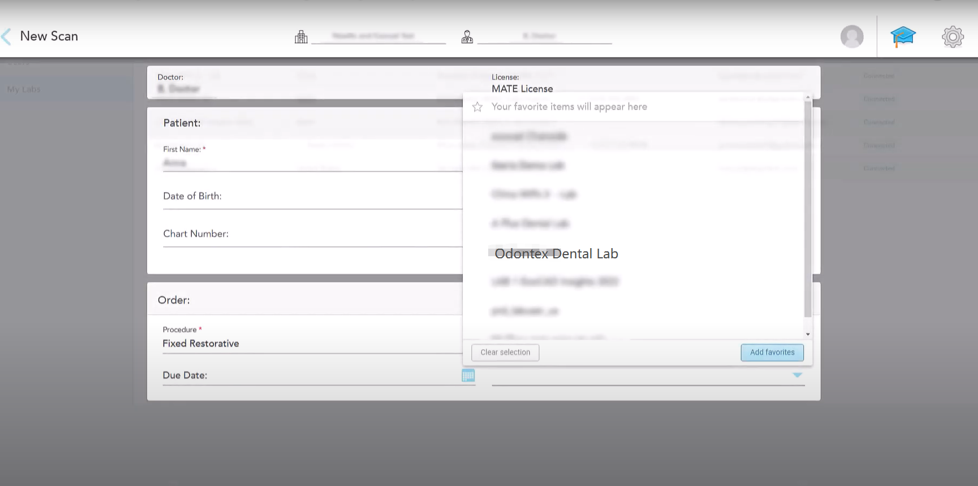
Step 11: After the connection is confirmed, Odontex will appear in your Send To list when completing your Rx

Slide 13
Thank you

