Slide 1


Odontex Dental Lab Scanner Connection Guide

Slide 2
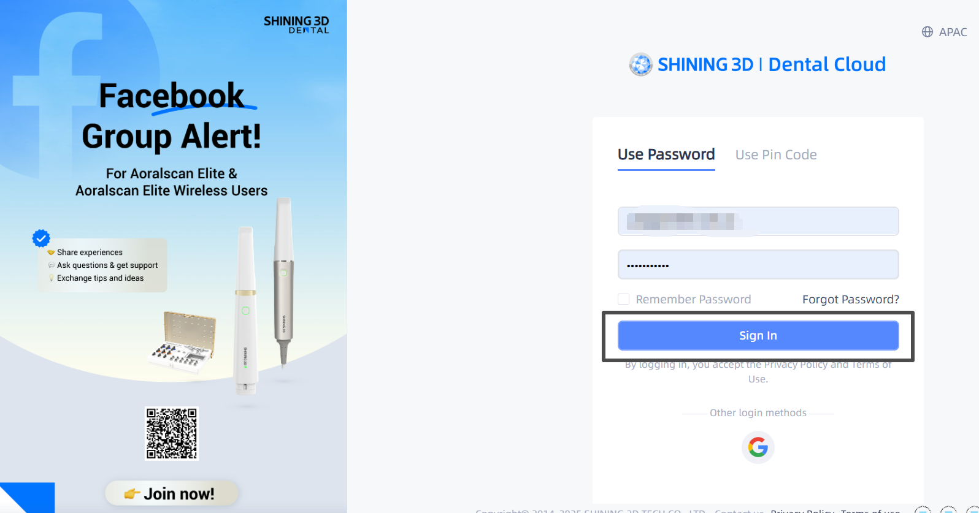
Step 1：Log in to your shining 3D account.

Slide 3
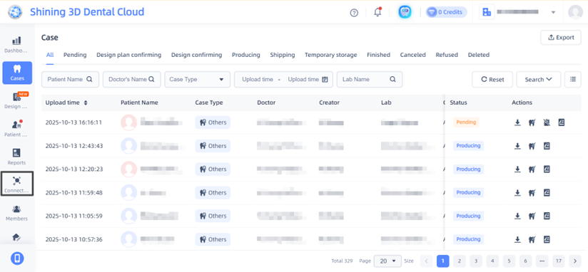
Step 2: Click the “Connections” tab on the right-hand panel.

Slide 4
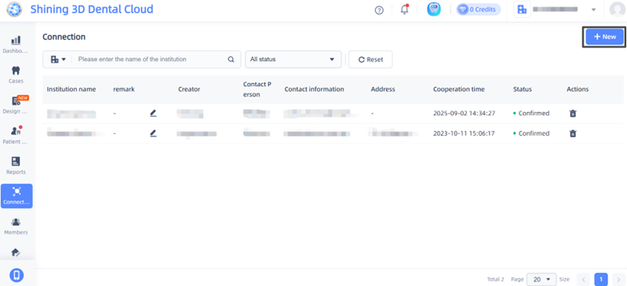
Step 3: Click the “+ New” button in the window.

Slide 5
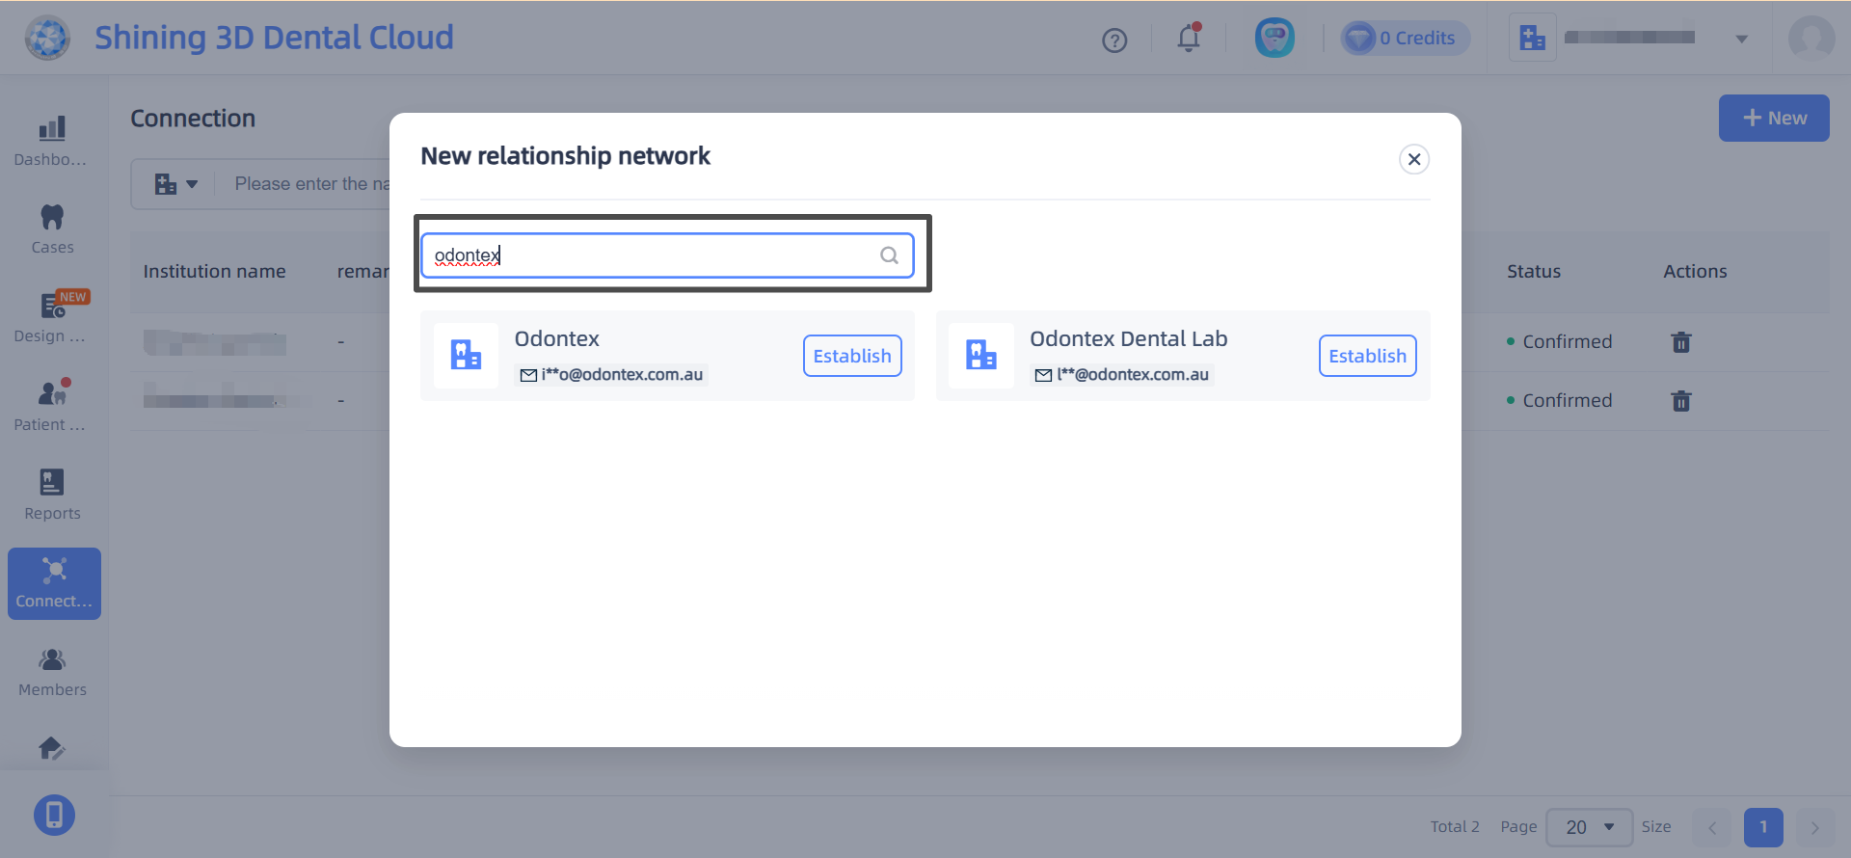
Step 4 : In the “Add Connections” window that pops up, enter our lab Name （Odontex )

Slide 6
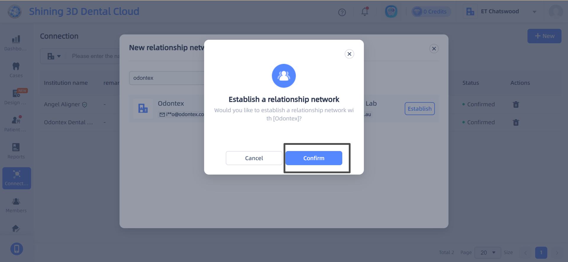
Step 5: Click the tick button to submit the request.

Slide 7
Thank you
Step 6: An approval request is automatically sent to our lab. Your connection status in the Add Connections window will be “Acceptance awaited” until we accept the request, then, it’ll change to “Active.”
Step 7: You can begin sending your cases to our lab.

