Slide 1


Odontex Dental Lab
Scanner Connection Guide

Slide 2
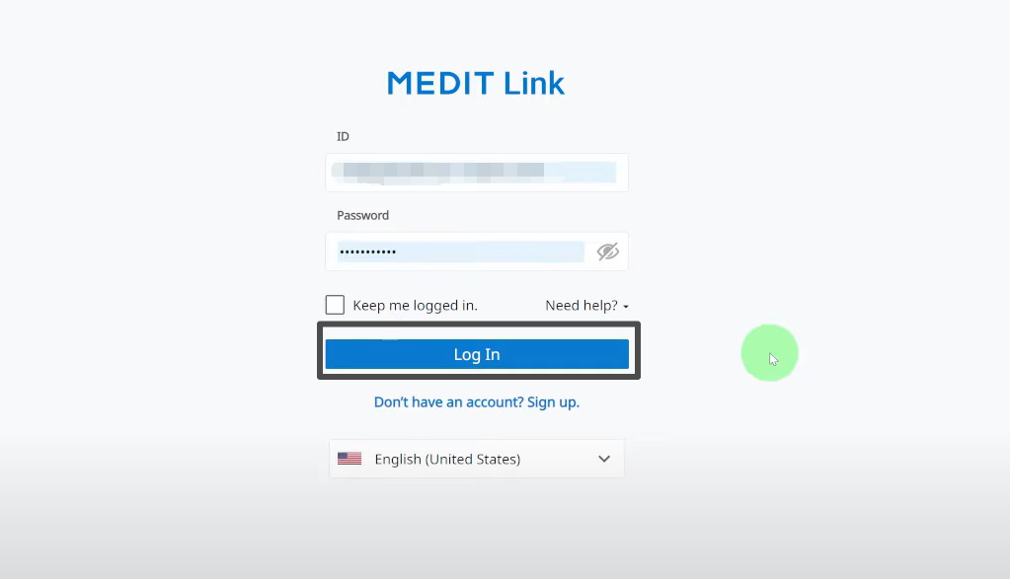
Step 1：Log in to your Medit Link account

Slide 3
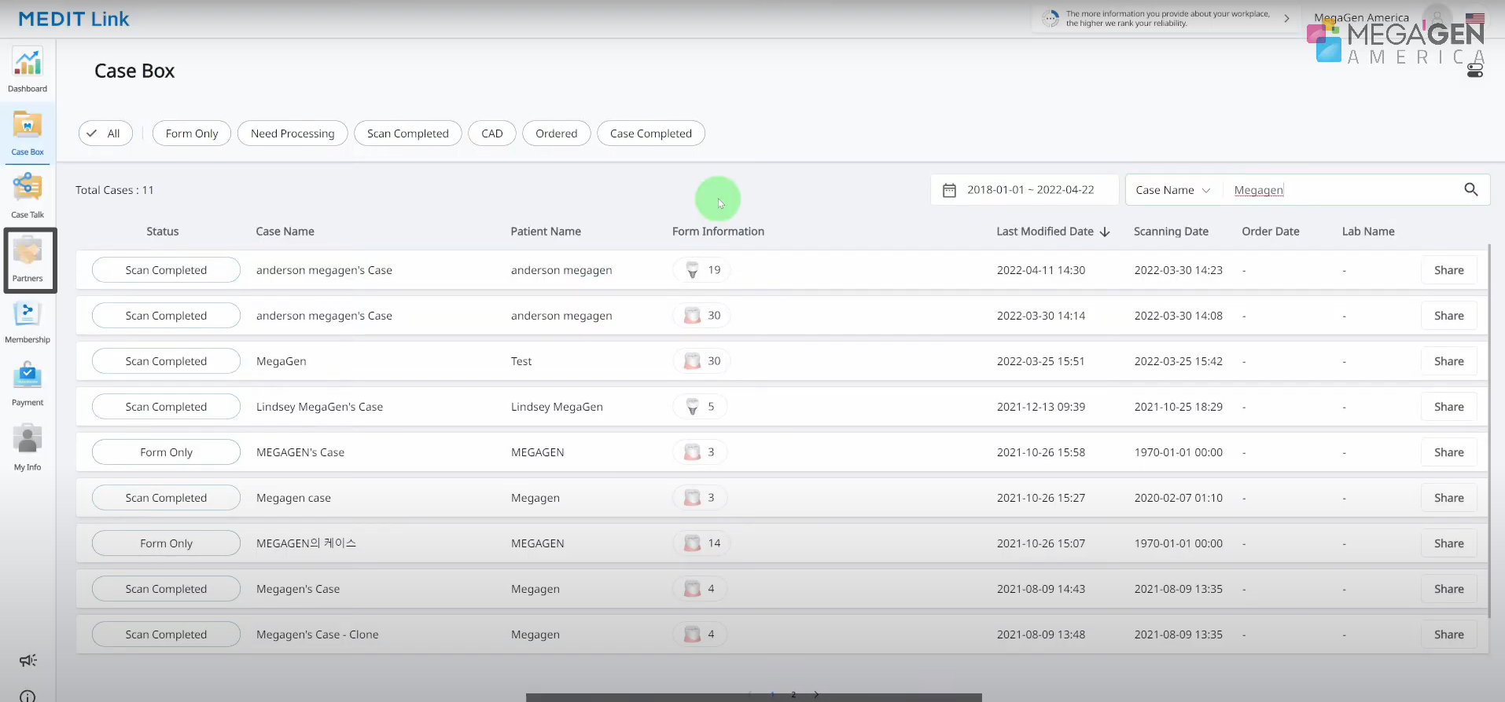
Step 2: From the left-hand menu, select Partners

Slide 4
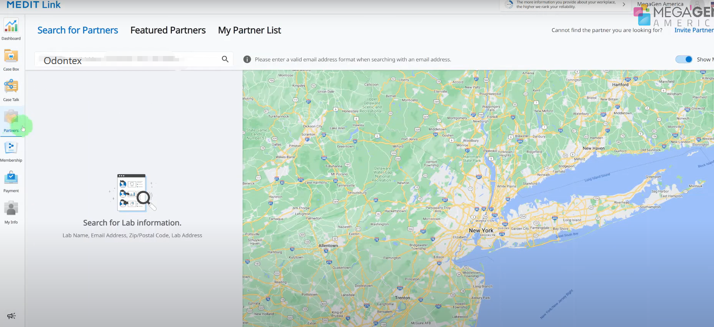
Step 3 : In the search bar, enter our lab’s name “Odontex” and to search our lab.

Slide 5
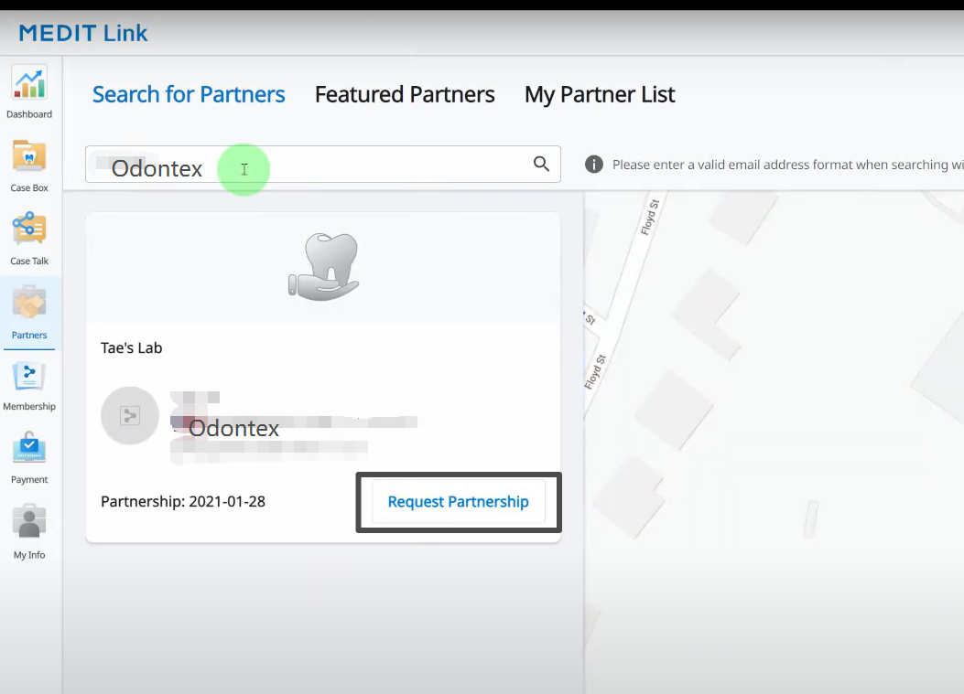
Step 4 : Find our lab in the results and click Request Partnership to send the request.

Slide 6
Thank you

