Slide 1



Odontex Dental Lab Scanner Connection Guide

Slide 2
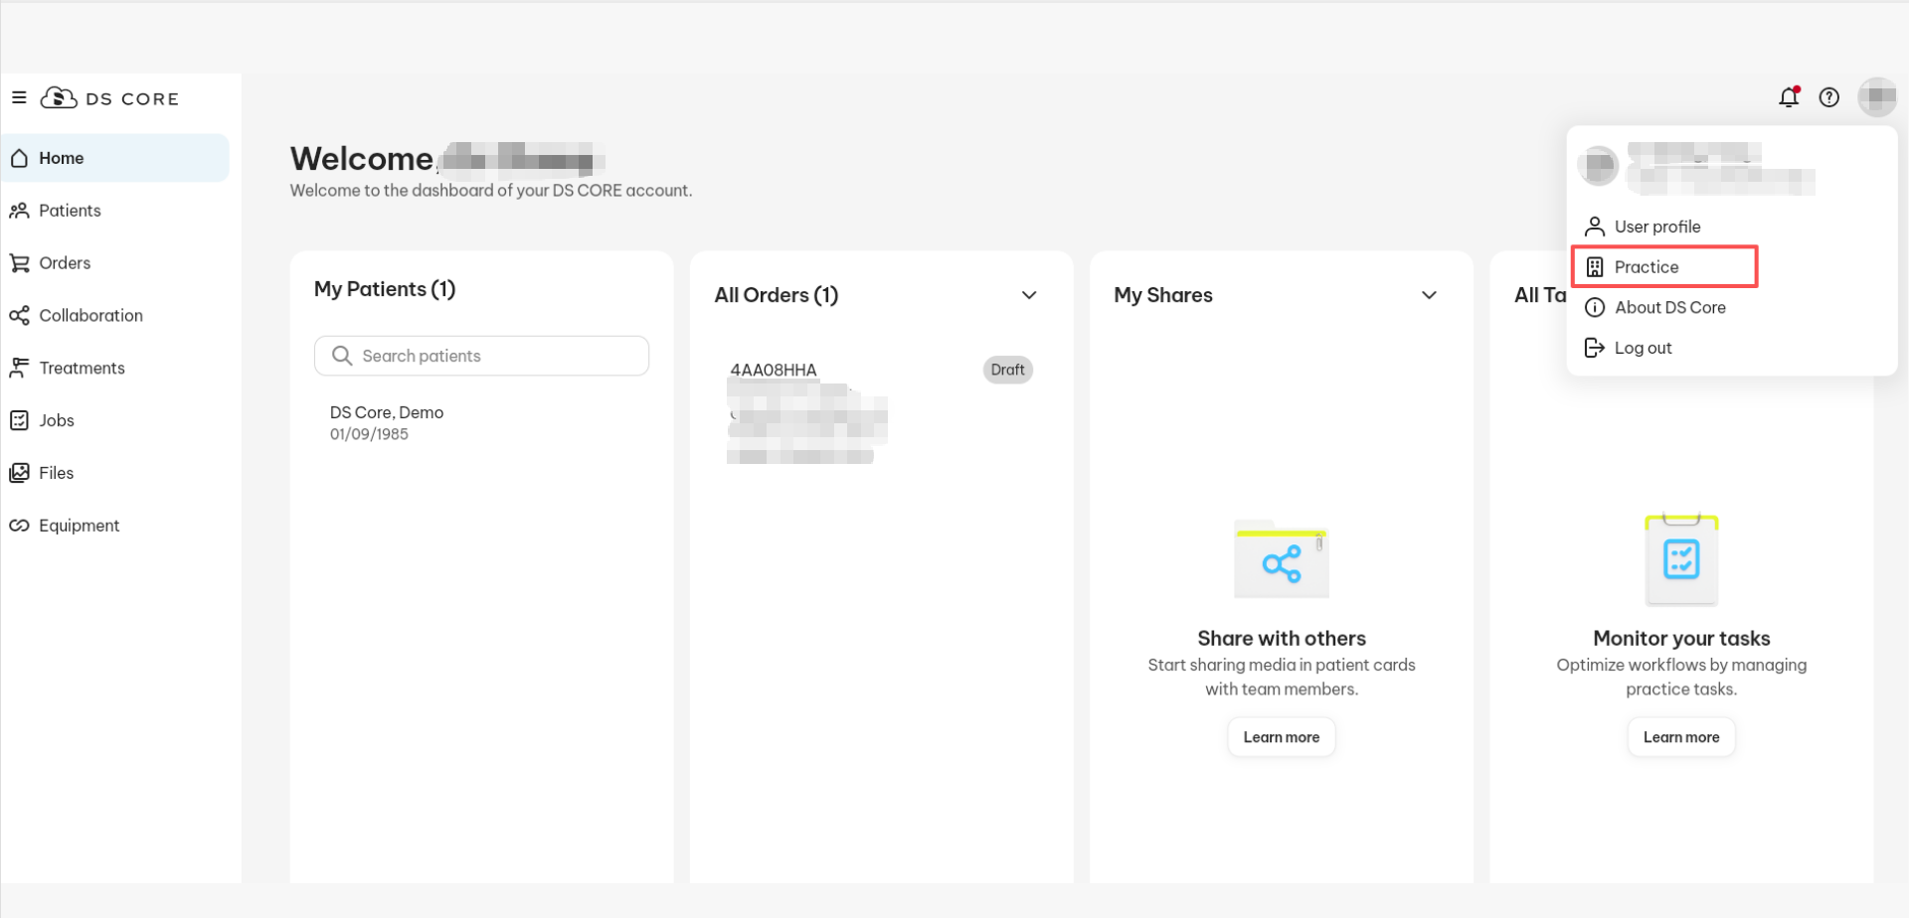
Step 1: Go to Your Practice Settings
1. From your DS Core dashboard, click on your profile icon in the top-right corner.
2 . Select Practice from the dropdown menu.

Slide 3
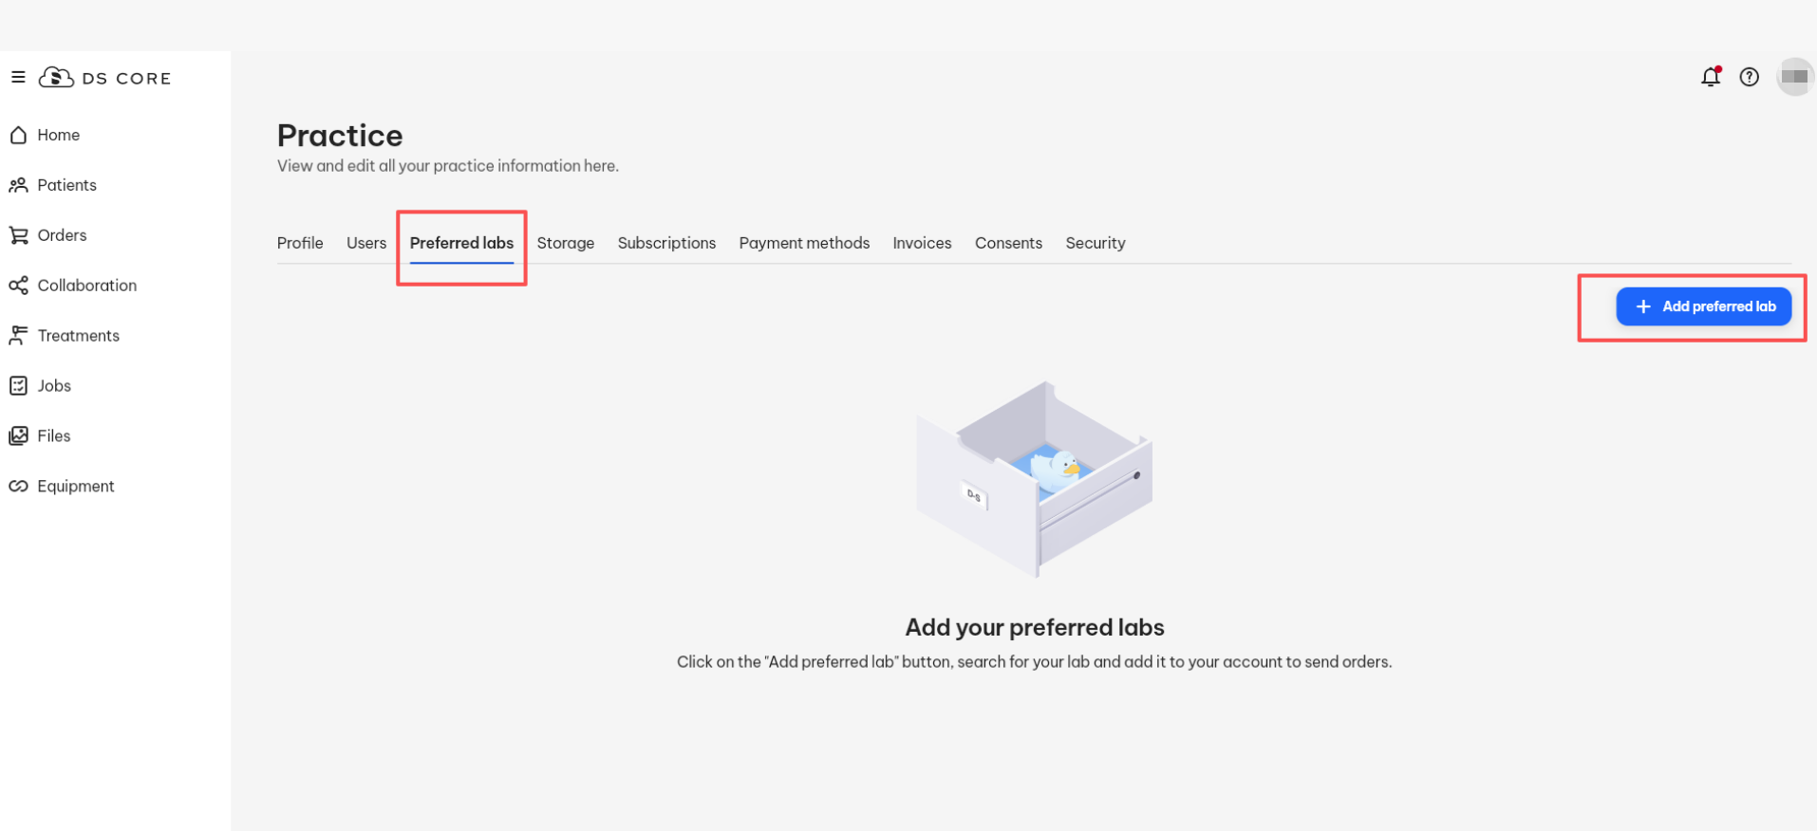
Step 2: Open the Preferred Labs Tab
1. In the Practice section, click on the Preferred labs tab.
2. Click the + Add preferred lab button on the right-hand side.

Slide 4
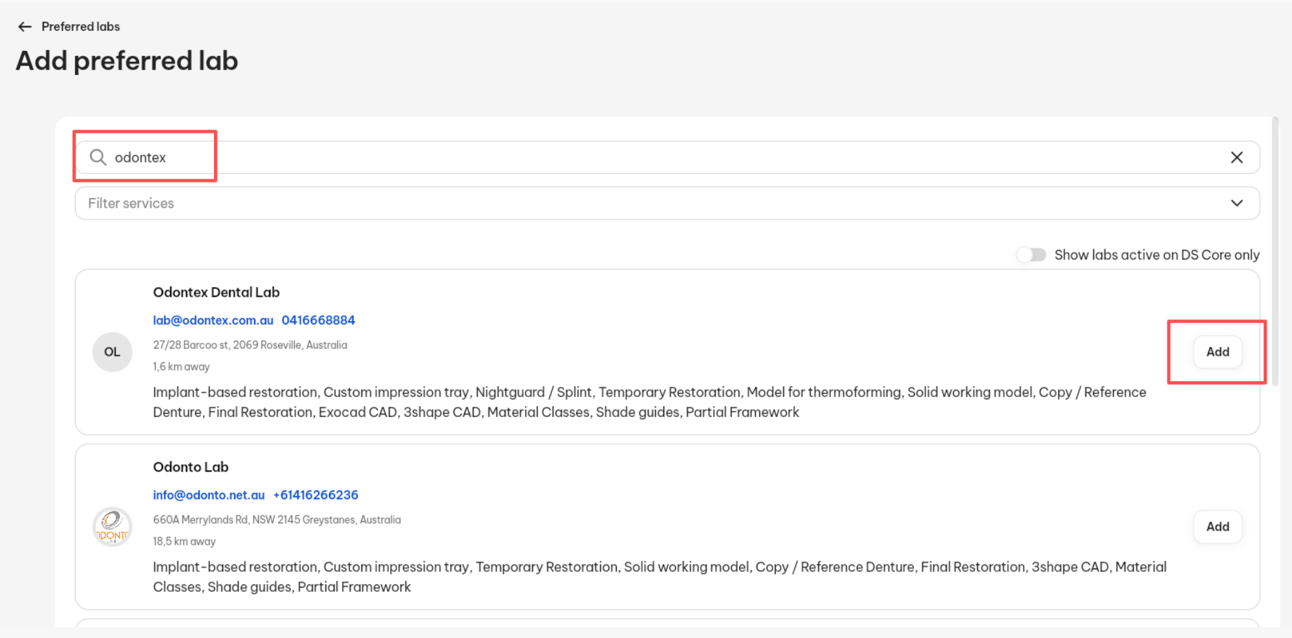
Step 3: Search for a Lab
1. In the Add preferred lab window, use the search bar to type our lab name “Odontex.”
2. The system will show a list of matching labs.

Slide 5
Thank you

