Slide 1


Odontex Dental Lab Scanner Connection Guide

Slide 2
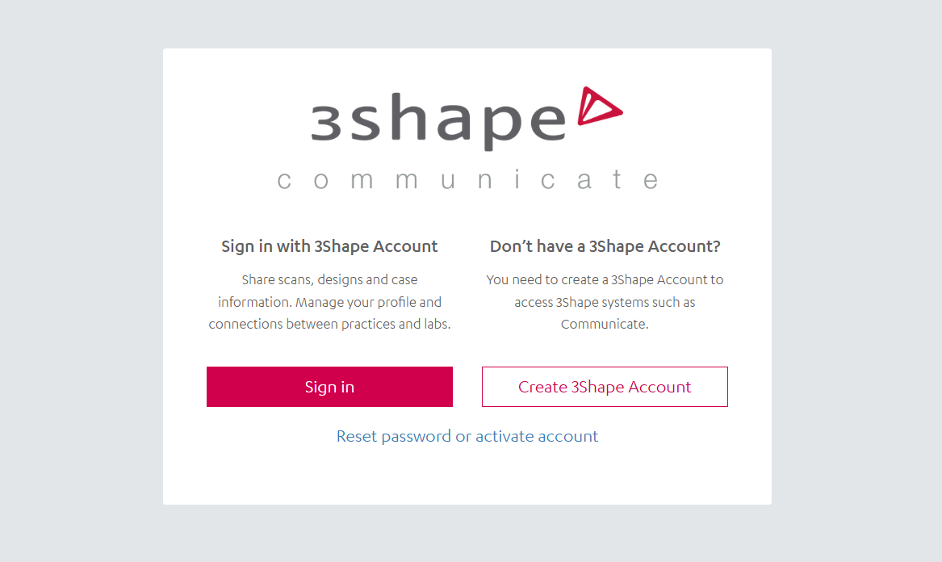
Step 1 : Login to your 3Shape Communicate account. If you don’t have one, click on ‘Create 3Shape Account’ and register for one.

Slide 3
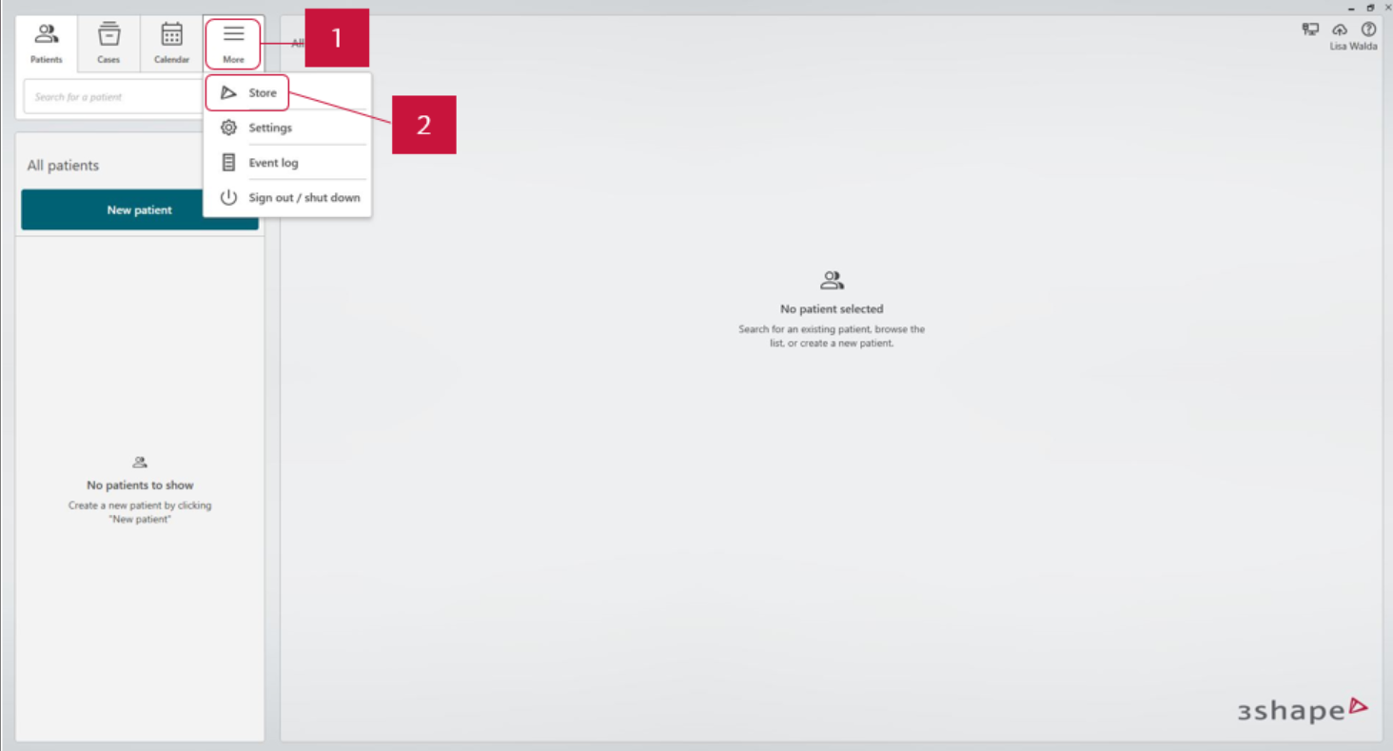
Step 2 : Open 3Shape Unite and go to ‘More’ and then click ‘Store’.

Slide 4
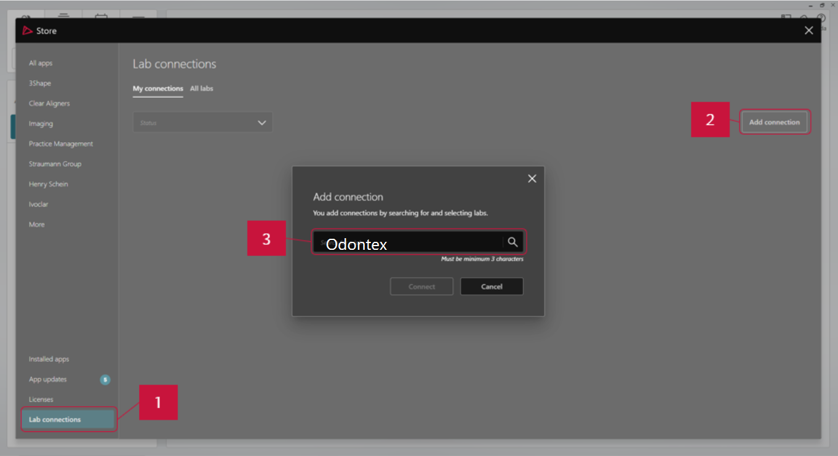
Step 3 : Go to ‘Lab connections’, click ‘Add connection’ button and type in details of the lab you want to connect to*. You can search Our lab name (Odontex)

Slide 5
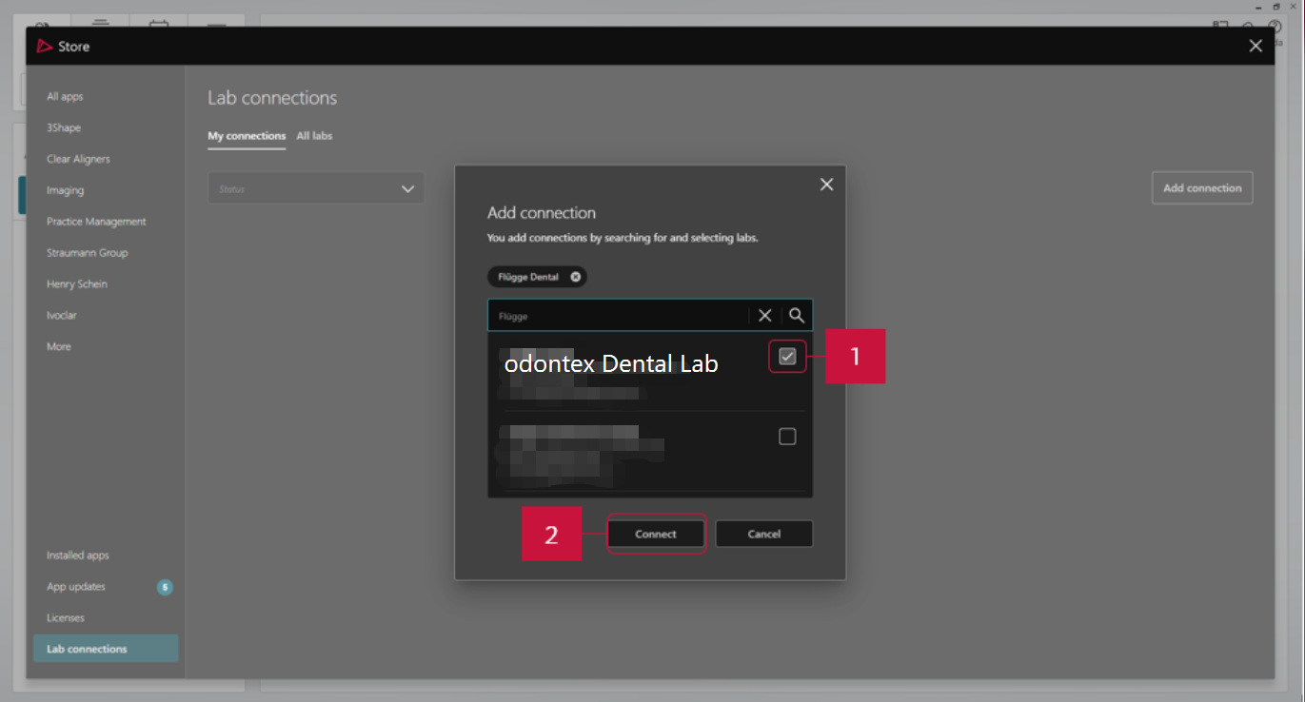
Step 4 : Select ‘Odontex dental lab’ in the results. Click ‘Connect’.

Slide 7
Step 5 : Once we approve your connection request, the status of Southern Cross Dental will change from ‘Waiting for approval’ to ‘Active’.
Step 6 : Go to your TRIOS® scanner, select ‘Configure’ > ‘Lab Connections’. Select ‘Communicate for External Connection’.
Step 7 : Click ‘Refresh’. Make sure Odontex dental lab appears in your Communicate list.

Slide 8
Thank you

